Slide 1
Word2Vec Representations
Team19

Slide 2
Abstract
word2vec is a group of related models that are used to produce word embeddings. Word embeddings are vector representations of words. They are positioned in the vector space such that words that share common contexts in the corpus are located in close proximity to one another in the vector space. These distributed representations of words in a vector space help learning algorithms to achieve better performance in natural language processing (NLP) tasks by grouping similar words. They serve as the most commonly used form of input feature representation of natural language text to deep learning models for NLP tasks.

Slide 3
Introduction
The approach used to learn these vector representations were borrowed from the improved Skip-gram and CBOW algorithms.
The first paper presents several improvements and extensions of the original Skip-gram model.
They show that subsampling of frequent words during training results in a significant speedup (around 2x - 10x) and improves accuracy of the representations of less frequent words.

Slide 4
Introduction
The second, CBOW algorithm is similar to the Skip-gram approach except that it learns vectos by predicting the missing center word from the context instead of the other way around as in the Skip-gram approach.
They call this architecture a bag-of-words model as the order of words in the history does not influence the vector space projection.
Furthermore, they use context words from the left and right of the center word. This enabled the model to capture both past and future dependence of words on the missing word

Slide 5
Datasets
The medical data used for the purpose of this project was a mixture of medical research articles and news articles which were crawled as follows.
Medical research articles published on Nature with the “Medical Research” and “Medical Reviews”. A total of 337 MB worth of research articles The sections scraped from those articles were (whichever were available): Abstract, Introduction, Methods, Results and Discussion
Entire text of medical news articles published on MedicalNewsToday from 2011 to April 2019. This amounted to 42 MB of textual data.

Slide 6
Dataset Cleaning
The exact step-wise procedure followed was as follows:
All ‘s were removed
Sentence tokenization was performed
All non alphabetical characters were removed
All stop words were removed
All words of length less than and equal to 2 were removed
After cleaning the raw data was reduced to 268 MB. The cleaned medical data contained 37.5 million tokens in total and a frequent vocabulary of 46,800 words is considered.

Slide 7
Datasets
We also use a small Wikipedia dump enwik9 as a substitute for plain english text. Of this data, a subsample of size 400 MB is taken which after cleaning reduces to 271 MB (comparable in size to the clean medical domain data). Thera are a total of 42.5 million tokens and a frequent vocabulary of 73,240 words is considered.

Slide 8
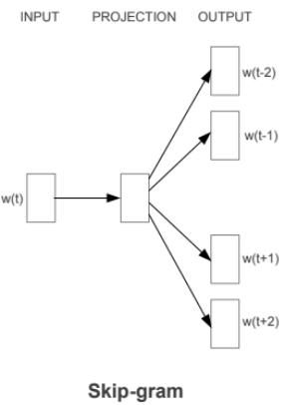
Skipgram Model

Slide 9
Skipgram Model
Skip-gram model tries to maximize classification of a word based on another word in the same sentence.
More precisely, it use each current word as an input to a log-linear classifier with continuous projection layer, and predict words within a certain range before and after the current word.
Since the more distant words are usually less related to the current word than those close to it, so it gives less weight to the distant words by sampling less from those words in the training examples. The training complexity of this architecture is proportional to
Q = C × (D + D × log₂(V))
where C is the maximum distance of the words.

Slide 10
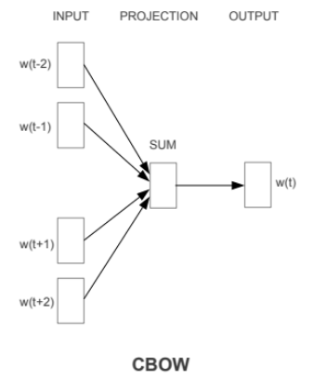
CBOW Model

Slide 11
CBOW Model
CBOW Model is similar to the feedforward NNLM, where the non-linear hidden layer is removed and the projection layer is shared for all words (not just the projection matrix); thus, all words get projected into the same position (their vectors are averaged).
Furthermore, we also use words from the future; a log-linear classifier with four future and four history words at the input is built, where the training criterion is to correctly classify the current (middle) word
Training complexity is then
Q = N × D + D × log₂(V)

Slide 12
Evaluation Criteria
Nearest neighbors
The cosine similarity between two word vectors provides an effective method for measuring the linguistic or semantic similarity of the corresponding words. This helps in finding the nearest neighbours for any given word.
Linear substructures
The word vectors also capture in a quantitative way the nuance necessary to distinguish words. They are designed such that the vector differences and additions capture as much as possible, the meaning specified by the juxtaposition of two or more words. Such vector operations also help solve different tasks like selecting out-of-the-list words, by computing average vector for a list of words and finding the most distant word vector.

Slide 13
Results
Examples of 3-nearest neighbours relationships
Word | Medical domain | Wikipedia
drug | drugs, antibiotic, artemisinin | drugs, marijuana, cocaine
brain | neurochemical, cns, cerebral | tumor, nervous, tissue
attack | attacks, palpitation, fluttering | assault, attacks, enemy
france | finland, netherlands, italy | italy, austria, germany
pathogen | organisms, pathogens, microorganisms | bacterium, parasite, tumors

Slide 14
Results
Examples of 3-NN with linear substructure relationships
Words | Medical domain | Wikipedia
france - paris + rome | mexico, rome, finland | gaul, sparta, persia
bigger - big + high | higher, low, greater | higher, low, greater
brains - brain + kidney | kidneys, isam, liver | smoker, drinker, drank
woman - man + men | women, men, woman | women, men, mothers
artery - artery + neuron | neuronal, neuron, microglial | collectible, iconic, ramped

Slide 15
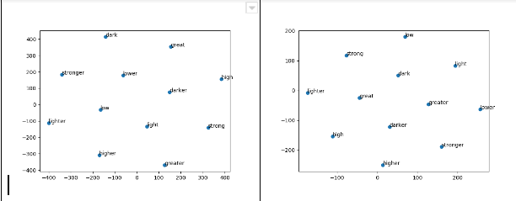
TSNE VISUALISATIONS

Slide 16
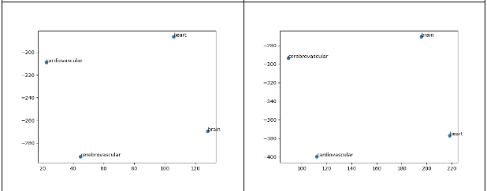
TSNE VISUALISATIONS

Slide 17
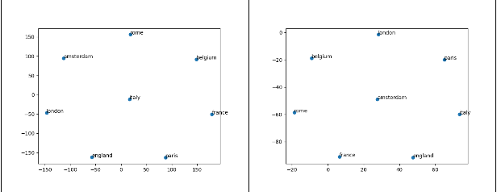
TSNE VISUALISATIONS

